Slide 1
Caching and performance in coldfusion
Presented by Denard Springle
at Adobe ColdFusion Summit 2019
Slides and code available at: https://github.com/ddspringle/cfsummit19-preso-assets

Slide 2
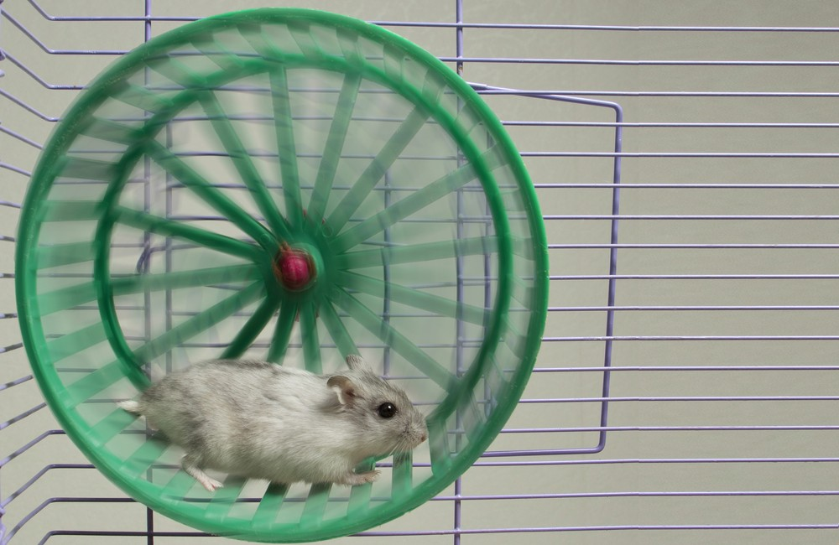
How To Care For
Your Hamsters
How To Care For Your Hamsters

Slide 3


Denard Springle
Senior Software Systems Engineer at MeetingPlay
20+ years polyglot developer
10+ years systems engineer
denard.springle@gmail.com
https://github.com/ddspringle

Slide 4
Agenda
Writing Performant Code
Caching Features of CFML
Practical Caching Examples
The secret to quick running code is… writing code that executes quickly, and wisely takes advantage of available resources.
Quick review of the caching functions available to CFML developers.
Caching in the real world can be fun and rewarding, lets see how.

Slide 5


Use modern techniques
Writing spaghetti code? Stahp!
Learn to implement OO and (H)MVC techniques in your every day development, stat!
Beans implement a common business object to operate on
Services encapsulate the data layer (database, api, queue, etc.)
Data layers can benefit greatly from caching techniques
Who toucha my spaghet?
Who toucha my spaghet?

Slide 6
Scope cascading wastes time
Always SCOPE your variables
form, url, cookie, session, application, client, request, arguments, variables, etc. – When no scope is provided, ColdFusion has to search all scopes sequentially until it finds a matching variable. This is time consuming.
To speed up execution, as well as eliminate ambiguity and potential security threats, always fully scope the variables you use. The only exception is the variables scope, which ColdFusion always scans first and is implied when defining any variable outside of a function.
var scope variables inside of functions. var myArray = [];

Slide 7
Fast exit vs delayed exit
if( !haveWhatINeed ) { exit } if( !haveWhatElseINeed ) { exit }
do something
Versus
if( haveEverything && iNeed ) { do something } else { exit } if( haveSomething ) { if( haveOtherThing ) { if( haveThisToo ) { do something } else { exit } else { exit } else { exit }
/handlers/fastExit.cfc

Slide 8

Break and continue
break; out of loops (for, while) and decision trees (switch { case }) once you have satisfied a condition
continue; over loops when data doesn’t need to be processed
GIBS ME A BREAK
GIBS ME A BREAK
/handlers/breakContinue.cfc

Slide 9
Use stored procedures
Take advantage of database server CPU/RAM resources
Stored procedures execute faster than queries
In services the Create, Read, Update and Delete (CRUD) functions should use stored procedures
Use SSMS Tools Pack to generate CRUD stored procedures https://www.ssmstoolspack.com/Download

Slide 10

Know your language
Avoid CPU intensive functions when alternatives exist structKeyExists() vs structFind() a++ vs incrementValue() ?: vs iif()
Use functional programming techniques e.g. map(), reduce(), filter(), each() – they’re typically faster
ColdFusion is a tool in your toolbelt. You should master it as you would any other tool. More knowledgeable developers earn higher wages.
I IS JEDI
I IS JEDI

Slide 11

Page Caching
<cfcache timespan='#CreateTimespan(1, 0, 0, 0)#' directory='e:/temp/page_cache’> <div>Hello World!</div> </cfcache>
You tell ColdFusion to cache the page results by putting a cfcache tag on your ColdFusion page before code that outputs HTML. The tag lets you specify the following information:
Whether to cache the page results on the server, the client system, or both. The default is both.
The directory on the server in which to store the cached pages.
The time span that indicates how long the page lasts until it is automatically flushed.
<cfcache action='flush' directory='e:/temp/page_cache’></cfcache>

Slide 12
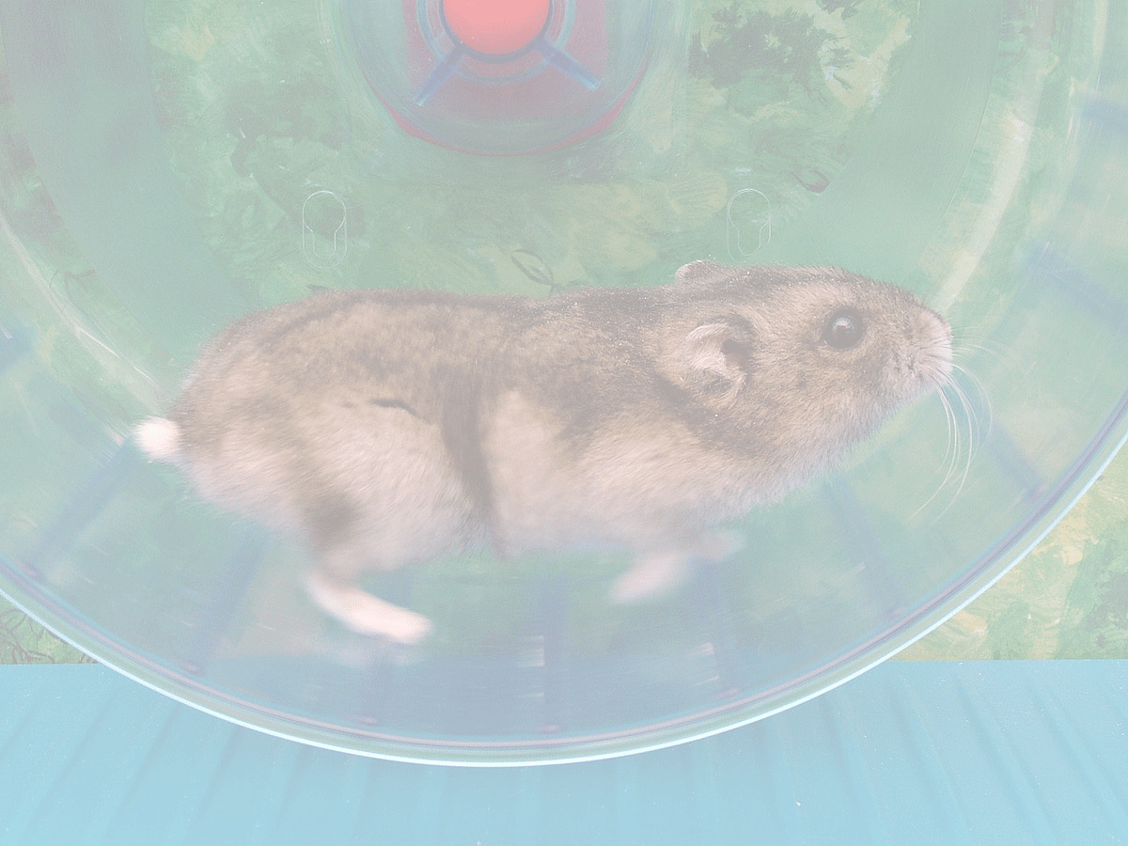
Content CACHING
cfsavecontent variable='session.myVar' {};
One handy but not very obvious way to use cfsavecontent() is in the Application or Session scope of your application.
By saving infrequently changing but frequently presented complex data in this way you can significantly decrease individual page load times.
Poor mans cache – not a best practice but good in a pinch in legacy code

Slide 13

Query Caching
qGetData = queryExecute( sql, params, { cachedWithin = createTimeSpan( 0, 1, 0, 0 );
Using the cachedWithin option to queryExecute() tells ColdFusion to save the results of the database query for a specific period of time
Data is retrieved from the database the first time the query is executed
For subsequent executions the data is retrieved from the cache instead until the cache expires
Managing and expiring query caches can be challenging – there are alternatives

Slide 14

ColdFusion 2018 caching
2018 Release adds additional caching engine options
Ehcache (default)
Java Caching System (JCS)
Redis (Enterprise)
Memcached (Enterprise)
JCS is faster than Ehcache, but not distributable
Redis and Memcached are slower but are distributable
this.cache.engine = 'jcs'; this.cache.configfile = '/path/to/cache.properties'; <- key/value pairs cacheGetEngineProperties()
https://coldfusion.adobe.com/2018/07/distributed-caching-coldfusion-2018-release/

Slide 15
CacheBox
CacheBox by Ortus provides multiple advanced features:
Cache Aggregators – Ability to aggregate multiple caching engines
Simple API – use a common set of functions across aggregate engines
Fully Configurable – convention and runtime configuration options
Cache Monitoring – Dashboard and commands panel
Use with or without ColdBox and other products in the *Box ecosystem

Slide 16

Object caching
The real work hamsters of caching
Retrieve and store any ColdFusion data type – struct, array, query, string, etc… even objects
cacheGet() / cachePut() / cacheRemove()
cacheGetAllIds() / cacheIdExists()
cacheGetMetaData() / cacheRemoveAll()
https://cfdocs.org/cache-functions
STAND BACK
I GOT DIS
STAND BACK
I GOT DIS

Slide 17
cacheGet and cacheput
// get your cached data
rc.myData = cacheGet( 'myCachedData' );
// check if your cached data still exists, or if we’re forcing a reload if( isNull( rc.myData ) || rc.clearCache = true ) {
// it doesn’t, or we are, get the data into rc.myData rc.myData = someComplexProcess();
// put it in the cache for an hour cachePut( 'myCachedData', rc.myData, createTimeSpan( 0, 1, 0, 0 ) );
} // do something with rc.myData

Slide 18
cacheremove
// get your cached data
rc.myData = cacheGet( 'myCachedData' );
// check if your cached data is still there if( !isNull( rc.myData ) ) {
// it is, remove it from the cache
cacheRemove( 'myCachedData' );
}
// get the data into rc.myData rc.myData = someComplexProcess();
// put it in the cache for an hour cachePut( 'myCachedData', rc.myData, createTimeSpan( 0, 1, 0, 0 ) );

Slide 19
We’re Hiring!
Mid-level ColdFusion developer
Legacy code - 50%
ColdBox projects w/ OOP, FP, member functions, etc. - 50%
Expert mentoring by yours truly and other senior devs
Send resume to hello@meetingplay.com or see me after the session for more information

Slide 20
Additional resources
http://learncfinaweek.com/course/index/section/Caching/item/Caching
http://learncfinaweek.com/course/index/section/Caching/item/Advanced_Caching

